Slide 1
Scikit-Learn Library
Provides several estimators: machine learning algorithms, models, and metrics.
Built on top of NumPy, SciPy, and Matplotlib
Open-source python library, tools for data mining and data analysis
Supports classification, regression and clustering algorithms
Support Vector Machine (SVM), Random Forest, gradient boosting, k-means, etc.
Seaborn for heatmap analytics

Slide 2
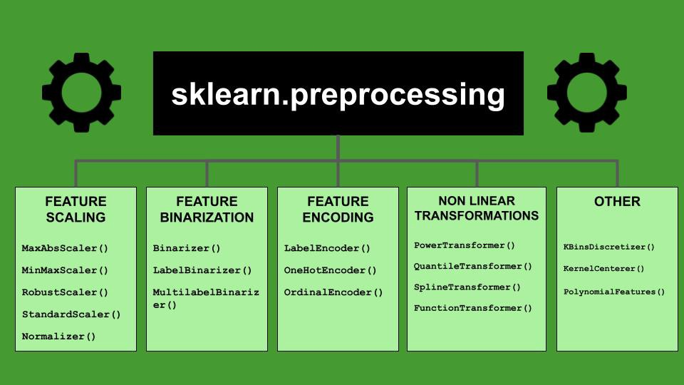
Scikit-Learn Capabilities
Towards Data Science

Slide 3
Using scikit-learn
List of features, libraries, methods available
API Reference — scikit-learn 1.5.0 documentation
Scikit-Learn Modules that We Use?
Metrics: Accuracy, Area Under Curve (AUC)
Principal Component Analysis
Classifier and Regressor: K-Nearest Neighbor
Classifier: Logistic Regression
Classifier: Gradient Boosting (time permits)

Slide 4
Principal Component Analysis
In multivariate analytics, we want to know which variables (or features) play more significant role over others?
What is the issue?
Computationally intensive. Data represented by multiple features is a non-linear problem.
Interdependence of data is often hard to assess
Lesser the number of features → better would be
Data interpretation, and
explain underlying physical processes.
How do we select significant features (instead of all features)?

Slide 5
Terminology
Rank Order. In PCA, we list parameters by the variation in descending order. This process helps with selecting top performers.
Standardized Data. Transform data into [0,1] interval. Note, if the distribution is skewed, standardization is not accurate.
Dimensionality Reduction. Reduce number of features (from original list). This involves dropping no/low-variance features without compromising for prediction accuracy.
Anomaly (detection). Unusual variations that are present in low-variance components
Noise. Small and repetitive parts of the signal (data) that doesn’t exhibit a pattern.
Decorrelation. Transform highly correlated components (aka features or their combination) into uncorrelated components.
Label. Text representing the categorical data

Slide 6
Terminology (Contd.)
Square Matrix. Coefficients of a system of linear equations. Also represents a linear transformation.
Covariance Matrix. A square matrix that captures the magnitude of the variance and its direction of a variable (feature) in multivariate analytics.
Vector. Quantity that has both direction and magnitude (or length)
Linear Transformation. When multiplied by a matrix, if length of the vector changes, it’s called linear transformation.
Non-linear Transformation. When multiple by a matrix, the length of the vector and/or its direction change, then the transformation is called non-linear.
Eigenvector. A vector whose direction remains unchanged when multiplied by a matrix.
Eigenvalue. The magnitude (or length) of the eigenvector. Represents variance in the direction of largest spread of the data.

Slide 7
How Do We go about PCA?
First and foremost, make sure the data is not skewed. Standardize the range of continuous initial variables (to eliminate technical bias)
Compute the covariance matrix to identify correlations among features
Compute the eigenvectors and eigenvalues of the covariance matrix to identify the principal components
You can think of eigenvectors as those that do not change over a transformation.
Create a feature vector to decide which principal components to keep
Recast the data along the principal component’s axes

Slide 8
Algorithm for PCA
Step 1: Setup a DataFrame for the dataset (X,Y) with X and Y representing features and Target of the sample
Step 2: Standardize dataset by subtracting the mean and dividing by the std. deviation
Step 3: Calculate the covariance matrix of features (X)
Step 3: Use Covariance matrix to find eigenvalues and eigenvectors
Step 4: Pick the top contributor eigenvalues → principal components.
Step 5: Pick the set of eigenvalues together describe data to the max (>85% is a good estimate). For this rank order percent eigenvalues.
Step 6: Pick top contributing eigenvalues (Dimensionality reduction)
Find % variance (information) accounted for by each eigenvalue
%ev1 = ev1/(sum of eigenvalues) * 100
%ev2 = ev2/(sum of eigenvalues) * 100, so on.
Step 7: Merge the eigenvectors into a matrix and apply* it to the data. Principal components are now aligned with the axes of our features. Keep reduced # of features that explain the most variation in the data!
*Note: Applying eigenvectors and eigenvalues will scale and rotate data

Slide 9
Review and follow diabetes-pca.ipynb
Principal Component Analysis (PCA) - easy and practical explanation (youtube.com)

